Slide 1
In Search of
CLEAR SKIES
UTOR Data Analytics Boot Camp - PROJECT 3
Team #9 Members:
Benjamin Kidston, Chu Nguyen Kien,
Gauri Gupta, Michelle Carvalho

Slide 2
INTRODUCTION
The team's approach was to visualize air quality in a meaningful way to a user interacting with our website. There are approximately 30 operating air quality stations in Southern Ontario, which collect readings on an hourly basis. Open source API data available at https://aqicn.org/ and drawn from the Ontario Ministry of the Environment air quality data and Open weather allowed the team to establish the framework for our project. We wanted to establish a tool for users to track air quality, and also visualize how air quality is impacted by factors, including abundance of green spaces, or proximity to energy production (ie. power plants).
Notes:
Gauri

Slide 3
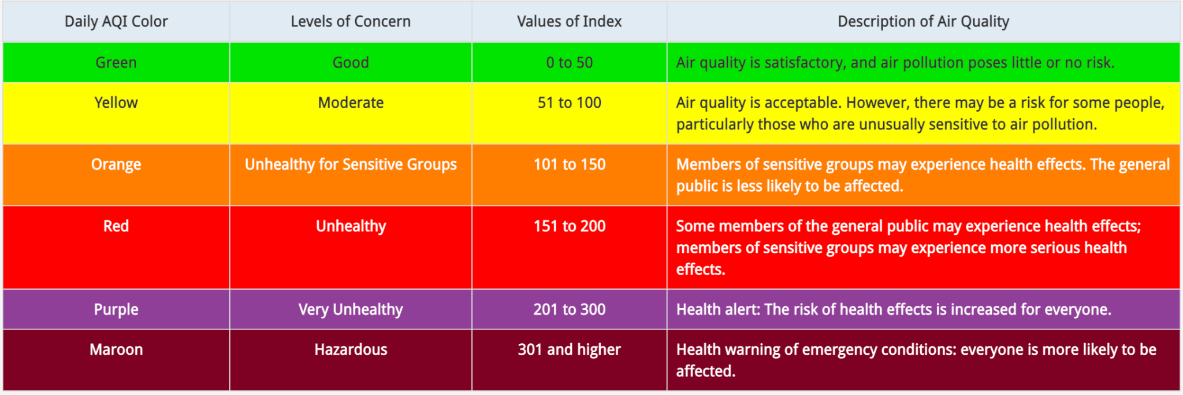
Air Quality…what is it?
When air quality is good, the air is clear and contains only small amounts of solid particle and chemical pollutants. Poor air quality, which contains high levels of pollutants, is often hazy and dangerous to health and the environment. Air quality is described according to the Air Quality Index (AQI), which is based on the concentration of pollutants present in the air at a particular location.
Notes:
Gauri

Slide 4
Scope of Project
Visualize air quality in a meaningful way to a user interacting with our dashboard.
Focused on Southern Ontario, where there are approximately 30 operational air quality stations that collect air quality readings on an hourly basis.
Interaction on the dashboard allows the user to select a station and track air quality readings, PM level forecasts, and temperature information.
A Leaflet map allows the user to visualize air quality throughout Southern Ontario and how it may be impacted by factors, including abundance of green spaces, or proximity to energy production (ie. power plants).
Notes:
Michelle
Focusing on Southern Ontario, as a team, we wanted to visualize air quality in a meaningful way. Users interacting with our dashboard, can select from any of approximately 30 air quality stations to see a reading of the air quality at that station employing a gauge for easy navigation, as well as particulate matter level forecasts and temperature information.
Additionally, a Leaflet map provides several layers of additional information, including geolocation and air quality index readings at stations in Southern Ontario, and juxtaposes these relative to parks and power/energy sources in Southern Ontario. The map is structured for maximum effect and adds additional interaction for the user, who can toggle views based on their preferences. Our goal in this particular visualization was to provide an opportunity to describe how air quality may be impacted by the proximity to abundant green space (ie. parks) or energy production (ie. power plants).

Slide 5
Data SOURCES Extraction & Transformation
Primary API data on air quality index collected from https://aqicn.org/map/canada/.
Ontario Ministry of the Environment - provided geolocation data for Ontario air quality stations
OpenWeather API - air quality/weather forecasting data
Parks data was generated from Geoapify API
Geolocations of power stations and other energy locations was pulled from the Global Power Plant Database (https://datasets.wri.org/dataset/globalpowerplantdatabase)
Minimal data cleaning:
Converting to JSON file, removing a few US locations, removing missing data from datasets
Created Python Flask-Powered API and PostgreSQL DB to pass our AQI data and create JSONified data set in an attempt to build persistent data storage and live functionality for our dashboard.
Notes:
Michelle
Our goal in searching for data sources focused on ensuring that the data was reliable, open source (APIs), compatible with our project goals, complementary (as we would need to access multiple sources) and could operate seamlessly across our dashboard.
The World Air Quality Index is a non-profit project started in 2007. Its mission is to promote air pollution awareness and provide unified and world-wide air quality information. As an open source resource, after requesting a “token” users can make up to 1000 requests a day. Additional information about each air quality station was gathered from the Ontario Ministry of the Environment (geolocation data), and OpenWeather that provided historical forecasts for air quality modelling.
You might recognize Geoapify from one of our earlier units. Creating an account to receive a free api key allowed us to pull data on specific place types within our set geographical boundaries. This provided us with thousands of geolocation points for parks. The vast quantity provided a challenge when mapping due to the density of point, that ultimately required a creative solution as will be revealed in a later slide.
While we could have used Geoapify to search for power stations, it only identified nuclear power stations (of which there are only 3 within our geographical boundaries). The Global Power Plant Database provided a list of nearly 250 energy producers (nuclear, hydro-electric, solar, wind) throughout Southern Ontario.
When focussing on Transformation of our data, the nature of the data that we were able to collect required very little transformation. For example, our geographic boundaries captured some US-based air quality stations, which we removed as they were not relevant to our project. We also tested the functionality of using a Python-Flask-Powered API, connected to a PostGreSQL database to transform our CSV data..

Slide 6
LIVE
DEMO
Notes:
Benjamin

Slide 7
Limitations and Challenges
Canada not densely populated with stations measuring AQI - compared to the US
We had to troubleshoot/find a solution for needing to host live server for CORS policy on weather/pm forecast
Cannot host the Flask API/PostgreSQL DB live on Github without additional user interfaces.
Certain KPI’s couldn’t be included because user has to pay further; calls are limited per day.
Notes:
Chu

Slide 8
Further Work
Include a larger variety of factors impacting air quality.
Expand our data set to cover a larger geographical region.
Create a CRUD to continuously create, read, update, and refresh our data and provide a live data stream and functionality to our dashboard.
Include additional contributing factors that may impact air quality (ie. weather, size of the population, environmental disturbances such as forest fires).
Create statistical modelling and analysis to compare the correlation of proximity between environmental factors and the air quality.
Hypothesis testing to evaluate the model.
Notes:
Chu

Slide 9
Summary
Interactive dropdown to select a city (event listener):
Visualized live AQI data colour-coded with a Gauge
Displayed a 7-day temperature and pollutant forecast using animated chart types like Spline, area and line.
Created a Leaflet map to show:
Parks - using a marker cluster plugin, custom markers
Power plants - using custom markers
AQI readings - using coloured markers to define air quality
Pop-ups provide additional information on data points
Users can change the view to isolate specific layers of the map using a toggle control
JQuery Javascript library provided additional functionality to simplify HTML manipulation, as well as event handling, and CSS animation for portions of the Leaflet map.
Notes:
Chu

Slide 10

QUESTIONS
Notes:
All

Slide 11
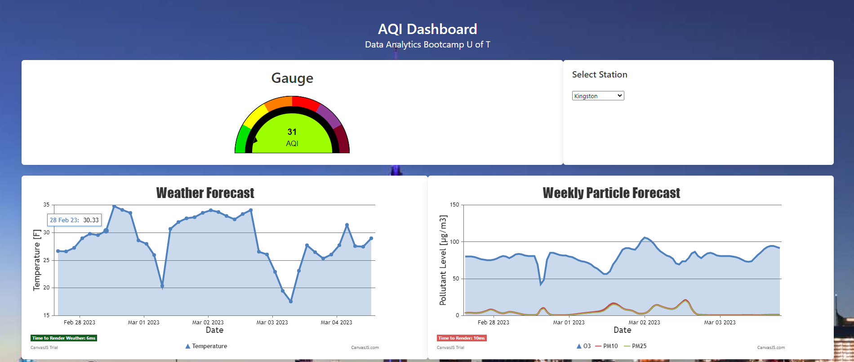
Loading DASHBOARD
Notes:
Benjamin

Slide 12
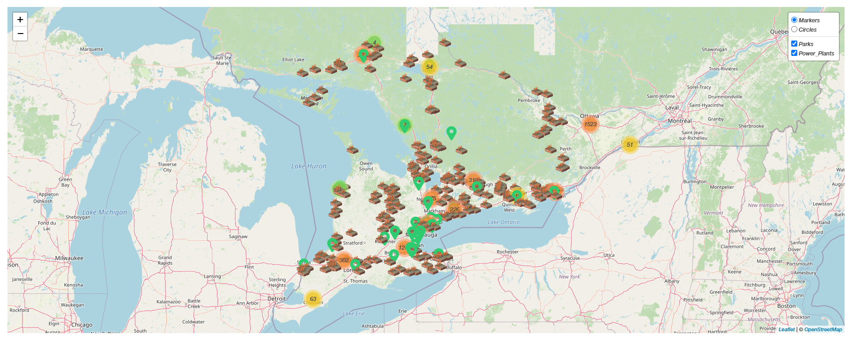
Loading DASHBOARD
Notes:
Benjamin

Slide 13
SCREENSHOTS
Cornwall
Toronto
Hamilton

